Slide 1
JAN BERVAR
GROUP SECURITY ARCHITECT

Slide 2
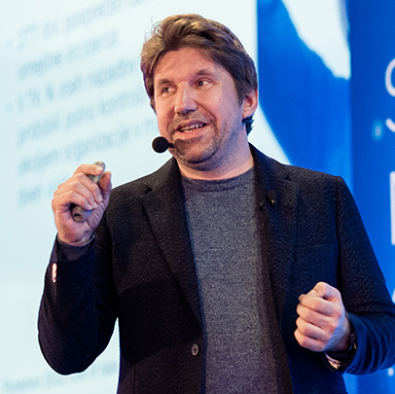
Trends
The long view on cybersecurity
Core trends
5 year focus
Spreker
Jan Bervar, Group Security Architect

Slide 3

The long view
Contrary to public perception, digital security has changed little in 40 years
Attacks and defences from 1980s
Attacker laziness
Industry use of mysticism
But
Change in motivation
Change in scale
Steady evolution of capability and focus

Slide 4

Trends: Motivation
Internet DoS
Encrypting ransomware
Unauthorized modification
Exfiltration / re-sell / leakage
(Large-scale) cryptomining
A new level of professionalism and customer intimacy

Slide 5

Trends:
AutomatIon
Of threats
Malware mutation
MFA AiTM
Believable phishing
and scams
Of defences
Prevention (YES)
Detection (NO*)
Response (NO)
Notes:
We can detect more and easier with ML, but the human workload to analyze is higher

Slide 6

Trends:
Zero trust
An agonizingly slow journey
Legacy / Organic / Standardized
Law of diminishing returns
Think of it as complexity reduction
…for initial access and lateration
Oh, they WILL get in
Notes:
An agonizingly slow journey of the last 30 days
Organic growth vs standardization vs legacy burden
Law of diminishing returns
Isolation
Prevention complexity reduction instead of ideal prevention
Criminals WILL get in (Microsoft’s greatest contribution to society), our job is to limit and disable them

Slide 7

Trends:
Weapons and battlefields
The era of controls moving closer to users and workloads
Very probably our End of History
Multicloud, PaaS, dynamic tooling has arrived
New regard for dev/test
Notes:
The promise of MDR
On average, our MDR customers have 2 incidents per year (and some as high as 20 per month)
Practically nobody has the internal capacity for the D of MDR, but effective R is easily achievable
It’s high time to stop focusing on SIEMs and network sensors for detection
The new kid on the block (XDR) has been here for 5 years now and has been 2-3x more effective and cost-effective
Abusing the XDR craze does not guarantee quality: vendors historically rebrand existing products with little honesty

Slide 8

Trends:
The rise of D&R
The big promise of MDR
R is easy, but D is hard
Protect the MDR provider’s business model
XDR is the way, but which XDR?
Industrialization of MDR is a concern
Why should MDR make you happy?
Notes:
The promise of MDR
On average, our MDR customers have 2 incidents per year (and some as high as 20 per month)
Practically nobody has the internal capacity for the D of MDR, but effective R is easily achievable
It’s high time to stop focusing on SIEMs and network sensors for detection
The new kid on the block (XDR) has been here for 5 years now and has been 2-3x more effective and cost-effective
Abusing the XDR craze does not guarantee quality: vendors historically rebrand existing products with little honesty

Slide 9

Focus for the next 5 years
Counter criminal monetization
Continue your zero-trust journey of pain, but curb your enthusiasm
Be one of the privileged ones that have intimate MDR, before it runs out
When mature enough, start moving your focus from coverage to assurance

